Slide 1

COMPENG 2SH4 Topic 8
More on Pointers
Introduction to DMA
Dr. Shahrukh Athar
Credit: The current version of these slides has been developed by Dr. Scott Chen (2SH4 F23 C02). I am using these slides with his permission and have made only slight modifications.

Slide 2

Agenda
Pointer Arithmetic Review
Pointers and Arrays
  Array-Index Format vs. Pointer-Offset Format
  Differences and Similarities in Declarations and Usages
  Pointers and Strings
Introduction to Dynamic Memory Allocation
  Review of Motivation
  Memory Management Routines
  Basic Usage of Memory Allocation Calls

Slide 3

Pointer Arithmetic Review
Watch Before Lecture:
[PLV 8-1] Pointer Arithmetic
[PLV 8-2] const Qualifier on Pointers

Slide 4
Pointer Arithmetic
Given pointer p points to an element of an array, and i > 0 is of type int, then…
  p + i is a pointer to the array element situated i-positions
  towards the array end from the element pointed by p,
  provided that it is within the array boundary
  p - i is a pointer to the array element situated i-positions
  towards the array head from the element pointed by p,
  provided that it is within the array boundary
  Thus, p + i and p - i are pointers of the same type as p
int* p;
0x 00732011
0x 0061FF20
int arr[5]
p + 1
arr[4]
0x 0061FF24
7
arr[3]
0x 0061FF20
6
arr[2]
0x 0061FF1C
5
p - 3
arr[1]
0x 0061FF18
4
arr[0]
0x 0061FF14
3

Slide 5
Pointer Arithmetic
Given pointer p points to an element of an array, and i > 0 is of type int, then…
  If q is another pointer to elements of an array, and q < p, then
  p – q is the number of array elements EXCLUSIVELY
  between the pointed elements + 1
    i.e. the difference between the pointed positions
  How does, for example, p + 1 translate to a 4 memory
  slot offset?
    C converts the pointer offset (1 unit) to memory
    slot offset (4 bytes) based on the size of int
    Implication:
      Same pointer offset results in different byte offset
      depending on the data type of the array
int* p;
0x 00732011
0x 0061FF20
int arr[5]
p + 1
arr[4]
0x 0061FF24
7
p – q
= 2
arr[3]
0x 0061FF20
6
arr[2]
0x 0061FF1C
5
p - 3
arr[1]
0x 0061FF18
4
arr[0]
0x 0061FF14
3
0x 005A33E2
0x 0061FF18
int* q;

Slide 6
Pointer Arithmetic – Example
float* aPtr;
0x 00732011
0x 0061FF20
Consider the following code snippet
  In more detail…
    $aPtr−bPtr=\frac{value of aPtr −value of bPtr}{sizeof(T)}$
      T is the data type of the array elements
      sizeof(T) returns number of bytes of a variable of type T
    $aPtr=\&a\left[6\right]= 0x61FF20 \left(6,422,30410\right)$
    $bPtr=\&a\left[2\right]= 0x61FF10 \left(6,422,28810\right)$
    $sizeof\left(float\right)=4 bytes \left(32 bits\right)$
    $aPtr−bPtr=\frac{6,422,304−6,422,288}{4}=\frac{16}{4}=4$
float a[8] = {0.0, 1.0, 2.0, 3.0, 4.0, 5.0, 6.0, 7.0};
float* aPtr = &a[6]; // Assume 32-bit (4 bytes) float
float* bPtr = &a[2]; // Assume 32-bit (4 bytes) float
float a[8]
a[7]
0x 0061FF24
7.0
a[6]
0x 0061FF20
6.0
aPtr – bPtr
= 4
a[5]
0x 0061FF1C
5.0
a[4]
0x 0061FF18
4.0
a[3]
0x 0061FF14
3.0
a[2]
0x 0061FF10
2.0
a[1]
0x 0061FF0C
1.0
a[0]
0x 0061FF08
0.0
0x 004A0E33
0x 0061FF10
float* bPtr;

Slide 7
Pointers and Arrays

Slide 8
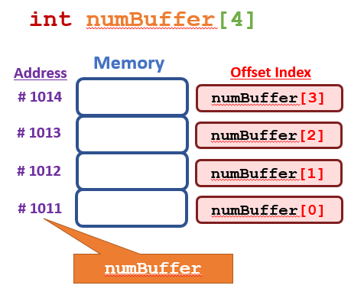
L8Ex3-PtrArray.c
Review – C Array
Recall – Name of an array is the address of the first element of the array
  Therefore, the name of an array is of pointer type
  However, NOT a pointer variable, but a constant pointer
    i.e. the address corresponding to the array name CANNOT be modified
  As a result, the dereferencing operator can be applied on array names!
    int numBuffer[4];
      numBuffer is a pointer to numBuffer[0]
      numBuffer+i is a pointer to numBuffer[i]
      *(numBuffer+i) is equivalent to numBuffer[i]
int a[6];
int *p = &a[1];
a = p; // Syntax Error!

Slide 9
L8Ex3-PtrArray.c
Applying Pointer Arithmetic to Arrays
Introducing – Pointer-Offset Form for Array Element Access
  Given the following code
  After p is assigned the value of a, p can be regarded as another name for array a.
  Thus, we have four possibilities to refer to element a[i].
    Array-Index(Subscript) Notation a[i]
    Pointer-Index(Subscript) Notation p[i]
    Pointer-Offset Notation *(p + i)
    Pointer-Offset with Array Name *(a + i)
int a[10];
int *p = &a[1];
p = a; // No Syntax Error, why?

Slide 10
L8Ex3-PtrArray.c
Pointers and Arrays – Example 1
int* p;
Consider the following code snippet
  Then, in order to access the last element in the array…
    Array-Index(Subscript) Notation a[4]
    Pointer-Index(Subscript) Notation p[4]
    Pointer-Offset Notation *(p + 4)
    Pointer-Offset with Array Name *(a + 4)
  If attempting *(p + 5) = 6 OR a[5] = 6 OR other equivalence…
    Outcome 1 – Step into unused memory region (heap or stack) by pure luck, nothing happens
    Outcome 2 – Step into used memory region by other part of the program, program malfunctions
    Outcome 3 – Step out of your defined memory region, either OS intervenes, or program crashes
    Takeaway – Just don’t. Be Careful.
0x 00732011
0x 0061FF14
int a[ ] = {2, 4, 6, 8, 9};
int* p = a;
// Alternatively, int* p = &a[0];
a[4]
p[4]
*(p+4)
*(a+4)
a[5]
0x 0061FF24
??
a[4]
0x 0061FF24
9
a[3]
0x 0061FF20
8
a[2]
0x 0061FF1C
6
a[1]
0x 0061FF18
4
a[0]
0x 0061FF14
2
int a[ ]

Slide 11
L8Ex4-LoopArray.c
Pointers and Arrays – Example 2
Looping through Array with Pointer
  First Loop – Iterating using Index Variable i
  Second Loop – Iterating using Pointer p
    Initialize p to the first element of the array.
    p incremented at the end of each iteration, thus pointing to the next element
int a[20];
int i;
int *p;
// Collecting Inputs into Array – Loop through Array using Index Variable
for (i = 0; i < 20; i++)
scanf(“%d”, &a[i]);
printf(“\n”);
// Print Array Elements – Loop through Array using Pointer Variable
for (p = a; p < a + 20; p++)
printf(“%d\t”, *p);

Slide 12
Passing Array as Input Parameter
Passing an array into a function
  What is actually passed into the function with array name?
    The value of the constant pointer – the address of the first element
  What is the input parameter receiving this address?
    It must match the incoming data type – a pointer variable (can be constant too)
    Such pointer type can be declared in the parameter list as:
      Array (Implicit Pointer) – int array[]
      Explicit Pointer – int* array
int a[20];
foo(a, 20); // passing array name and size into the function foo().
// foo() then should have the following function signature
foo(int array[], int size); // Array Name (Implicit Pointer)
// OR
foo(int *array, int size); // Explicit Pointer

Slide 13
L8Ex5-ArrayPass.c
Pointers and Arrays – Example 3
// f1() uses Array Name format for input (Implicit Pointer)
void f1(int pa[], int n)
{
int i;
for( i = 0; i < n; i++)
{
pa[i] *= 2; //array-index
printf(“a[%d]=%d\n”, i, *(pa + i)); //pointer-offset
}
}
Passing Parameters of Array Type
#include <stdio.h>
#define N 3
// Two IDENTICAL Array-Processing Functions
void f1(int pa[], int n);
void f2(int *pa, int n);
int main(void)
{
int a[N] = {0, 1, 2};
// Both will multiply elements by 2
// and print them out
f1(a, N);
f2(a, N);
return 0;
}
All four array element access formats can be interchangeably used
// f2() uses Explicit Pointer format for input
void f2(int* pa, int n)
{
int i;
for( i = 0; i < n; i++)
{
*(pa + i) *= 2; //pointer-offset
printf(“a[%d]=%d\n”, i, pa[i]); //array-index
}
}

Slide 14
Watchout! Pointer and Array Declarations
Pointer Declaration and Array Declaration are Equivalent only when…
  They are declared in the input parameter list of a function
    Because the actual data array would have already been defined in memory in the caller
  They are NOT EQUIVALENT otherwise!!
int* pa;
…
int main(void)
{
int a[N] = {0, 1, 2};
f1(a, N);
f2(a, N);
…
}
void f1(int pa[], int n)
{…}
0x 00732011
0x 0061FF1C
void f2(int* pa, int n)
{…}
a[2]
0x 0061FF24
2
a[1]
0x 0061FF20
1
a[0]
0x 0061FF1C
0
Except…Strings!
int a[3]
0x 00233EE1
0x 0061FF1C
int a[3] = {0, 1, 2}; // Valid, memory allocated and value stored
int* p = {0, 1, 2}; // INVALID, declaring pointing does not allocate memory
// i.e. Values in the init. list have nowhere to go
int pa[];

Slide 15
Pointers and Strings – Valid Declarations
Strings declared + defined through Character Array – Variable Character Arrays
  Can be modified after being initialized
  Array name is the constant pointer to the first char of the string
Strings defined through Character Pointer + Init. String – Constant Strings
  CANNOT BE MODIFIED after being initialized
  A character array is created in read-only memory to store the string. Pointer is assigned the address of the array
L8Ex6-PtrString.c
char str[20];
scanf(“%s”, str);
// After user input,
// contents can be modified
char str[20] = “Hello World!”;
// After user input, contents can be modified
str[3] = ‘L’; // this is OK
char *str = “Hello World!”;
// “Hello World!” is placed as a character array in read-only memory
// str then points to the start of this array.
str[3] = ‘L’; // This modification is NOT ALLOWED, because of read-only memory

Slide 16
Pointers and Strings – Invalid Declaration
Valid: Strings defined through Character Pointer + Init. String – Constant Strings
  CANNOT BE MODIFIED after being initialized
  An array is created in read-only memory to store the string. Pointer is assigned the address of the array
Invalid: Strings declared through Character Pointer + Other Init. Methods
  Problem: Declaring a pointer will not automatically result in allocated memory
char *str;
str = “Hello World!”;
// “Hello World!” is placed as a character array in read-only memory
// str then points to the start of this array.
str[3] = ‘L’; // This modification is NOT ALLOWED, because of read-only memory
char *str;
scanf(“%s”, str);
// This is compilable but will potentially lead to seg fault or data destruction, because scanf() will scan into an unallocated memory section
L8Ex6-PtrString.c

Slide 17
Pointers and Strings – Example
L8Ex7-StrLen.c
Let’s build our own string length calculation function (Excluding NULL)
#include <stdio.h>
int main(void)
{
int i = 0;
char* str = “John”;
i = my_strlen(str);
printf(“Total String Length: %d\n”, i);
return 0;
}
char* str;
0x 00732011
0x 0061FF1C
0x 0061FF1C
0x 0061FF20
‘\0’
0x 0061FF1F
‘n’
0x 0061FF1E
‘h’
0x 0061FF1D
‘o’
0x 0061FF1C
‘J’
// Return the string length, EXLUCDING Null
int my_strlen(char* s)
{
int k;
for( k = 0; *s != ‘\0’; s++)
k++;
return k;
}
Read-Only
Pointer as index var
0x 0025DEAE
char* s;

Slide 18
Pointers and Strings – Example
L8Ex7_2-StrLen2.c
With the same my_strlen() function, what would be the printf() output?
#include <stdio.h>
int main(void)
{
int i = 0;
char array[] = “Welcome!”;
char* str = “COMPENG 2SH4”;
i += my_strlen(“Hello World!”);
i += my_strlen(array);
i += my_strlen(str);
printf(“Total String Length: %d\n”, i);
return 0;
}
// Return the string length, EXLUCDING Null
int my_strlen(char* s)
{
int k;
for( k = 0; *s != ‘\0’; s++)
k++;
return k;
}
Total String Length: 32

Slide 19
Dynamic Memory Allocation
Watch Before Lecture:
[PLV 8-3] Introduction to DMA

Slide 20
DMA Management Routines in C
Allow us to freely control when objects are created and destroyed
  Memory management functions for DMA are available in the C standard utility library <stdlib.h>
CREATE
CREATE (and 0-init)
malloc()
calloc()
ADJUST SIZE
Destroy
realloc()
free()

Slide 21
DMA Management Routines in C
Allow us to freely control when objects are created and destroyed
  Memory management functions for DMA are available in the C standard utility library <stdlib.h>
  malloc(), calloc(), and realloc()
    Allocate a contiguous portion of memory (consecutive bytes)
    Return a generic pointer to the first byte of the memory sector
  free()
    The allocated memory remains allocated
    until the deallocation call is made
    Otherwise?
CREATE
malloc()
Like Arrays!
CREATE (and 0-init)
calloc()
Destroy
ADJUST SIZE
free()
realloc()
Memory Leak!

Slide 22
DMA Management Routines in C
malloc(), calloc() and free() are discussed in [PLV 8-3]
Can also adjust the variables size dynamically
  Available in the C standard utility library <stdlib.h>
  void* realloc( void* p, size_t new_size );
    Change the size of the memory sector pointed by p to new_size
    Returns a pointer to the new block, or NULL if request is unfulfilled
    Existing contents in the old block will remain unchanged
      When downsizing, p most likely will remain the same
      When upsizing, p may change for a larger sector on the heap
        Additional spaces will be uninitialized
    What happens to the old block?
      Typically, realloc() frees the old block automatically if moved to a new memory sector
ADJUST SIZE
realloc()

Slide 23
DMA Management Routines in C
ADJUST SIZE
Can also adjust the variables size dynamically
  Available in the C standard utility library <stdlib.h>
  void* realloc( void* p, size_t new_size );
    Example of Upsizing…
      Case 1 – When memory sector can be expanded as is
realloc()
int* p;
0x 00732011
0x 0061FF1C
0x 0061FF1C
0x 0061FF28
??
int *p, *q;
p = (int*)calloc( 3, sizeof(int) );
if( p == NULL ) return -1; // C error check
// after some work…
q = (int*)realloc( p, 4 * sizeof(int) ); // should error check
free(q); // DMA Memory Deallocation
free(p); // Not Necessary – freeing q is enough
0x 0061FF24
882
0x 0061FF20
-3
0x 0061FF1C
78
on Heap
0x 0025DEAE
int* q;

Slide 24
ADJUST SIZE
DMA Management Routines in C
realloc()
0x 0082130C
int* p;
Can also adjust the variables size dynamically
  Available in the C standard utility library <stdlib.h>
  void* realloc( void* p, size_t new_size );
    Example of Upsizing…
      Case 2 – When new memory sector is assigned
0x 00732011
0x 0061FF1C
0x 0061FF1C
0x 0061FF24
882
882
-3
0x 0061FF20
-3
78
0x 0061FF1C
78
on Heap
int *p, *q;
p = (int*)calloc( 3, sizeof(int) );
if( p == NULL ) return -1; // C error check
// after some work…
q = (int*)realloc( p, 4 * sizeof(int) ); // should error check
free(q); // DMA Memory Deallocation
free(p); // Not Necessary – Already freed by realloc()
0x 00821318
??
0x 00821314
0x 00821310
0x 0082130C
on Heap
0x 0025DEAE
int* q;

Slide 25
DMA Management Routines in C
ADJUST SIZE
Can also adjust the variables size dynamically
  Available in the C standard utility library <stdlib.h>
  void* realloc( void* p, size_t new_size );
    Example of Downsizing…
      Most likely staying in the same memory sector
realloc()
int* p;
0x 00732011
0x 0061FF1C
0x 0061FF1C
int *p, *q;
p = (int*)calloc( 3, sizeof(int) );
if( p == NULL ) return -1; // C error check
// after some work…
q = (int*)realloc( p, 2 * sizeof(int) ); // should error check
free(q); // DMA Memory Deallocation
free(p); // Not Necessary – freeing q is enough
0x 0061FF24
882
0x 0061FF20
-3
0x 0061FF1C
78
on Heap
0x 0025DEAE
int* q;

Slide 26
DMA Example 1
L8Ex8-VarArray.c
Creating an array of size specified at runtime
p = (float*)malloc(n * sizeof(float));
if(p == NULL) // Standard C-style Error Handling
{
printf(“\nOut of Memory!\n”);
return -2;
}
for( i = 0; i < n; i++) // acquire values
{
printf(“Input Array Element %d: ”, i);
scanf(“%f”, p + i);
}
for( i = 0; i < n; i++) // print values
{
printf(“p[%d] = %6.2f\n”, i, *(p + i));
}
free(p); // Defeat the Memory Leak!!
return 0;
}
#include <stdio.h>
#include <stdlib.h> // for memory management
int main(void)
{
int n, i;
float* p = NULL; // for DMA array on heap
printf(“Input the size of the array: n = ”);
scanf(“%d”, &n);
if(n <= 0) // Standard C-style Error Handling
{
printf(“\nInvalid Entry!\n”);
return -1; // indicating execution error
}
printf(“\n”); // formatting

Slide 27

DMA Example 2
Design a function to add two n-dimensional vectors
  Each vector is stored in an n-size array
  The array names corresponding to the vector operands are passed into the function as arguments
    Where to store the sum vector?
      Option 1 Create a sum array in the caller, and pass its name into the function
      Option 2 Create a sum array in the function, and return a pointer to it back to the caller
Option 1
Sum vector array has a storage duration of the caller block
It will be allocated well before add() is called, but only used in add() and afterwards.
Inefficient Memory usage
Option 2
Sum vector array has a storage duration completely under our control
It will be allocated RIGHT BEFORE being used in add(), and sustain until free() is called
Efficient Memory usage
However, you are responsible for deallocation!

Slide 28
DMA Example 2
Vector Add Function with DMA
L8Ex9-Add2VecV3-Works.c
#include <stdio.h>
#include <stdlib.h> // for memory management
int* add( int v1[], int v2[], int n );
int main(void)
{
int vec1[] = {1, 2, 3, 4};
int vec2[] = {4, 3, 2, 1};
int* p = NULL; // for storing sum result
p = add( vec1, vec2, 4 );
printf(“%d, %d, %d, %d\n”, p[0], p[1], p[2], p[3]);
free(p); // Beat the Memory Leak!!
return 0;
}
// Vector Add Function
int* add( int v1[], int v2[], int n )
{
int *sum = (int*)malloc( n*sizeof(int));
int i;
for( i = 0; i < n; i++)
{
sum[i] = v1[i] + v2[i];
}
return sum;
}

Slide 29
DMA Example 2
Vector Add Function – Bad workaround to avoid DMA
L8Ex9-Add2VecV1-Fail.c
L8Ex9-Add2VecV2-Fail.c
#include <stdio.h>
int* add( int v1[], int v2[], int n );
int main(void)
{
int vec1[] = {1, 2, 3, 4};
int vec2[] = {4, 3, 2, 1};
int* p = NULL; // for storing sum result
p = add( vec1, vec2, 4 );
printf(“%d, %d, %d, %d\n”, p[0], p[1], p[2], p[3]);
return 0;
}
// Vector Add Function – without DMA V1
int* add( int v1[], int v2[], int n )
{
int sum[n];
int i;
for( i = 0; i < n; i++)
{
sum[i] = v1[i] + v2[i];
}
return &sum[0]; // OR return sum;
}
This will fail because sum[] is destroyed at the end of add(), thus cannot be accessed even with a pointer passed back to caller.

Slide 30
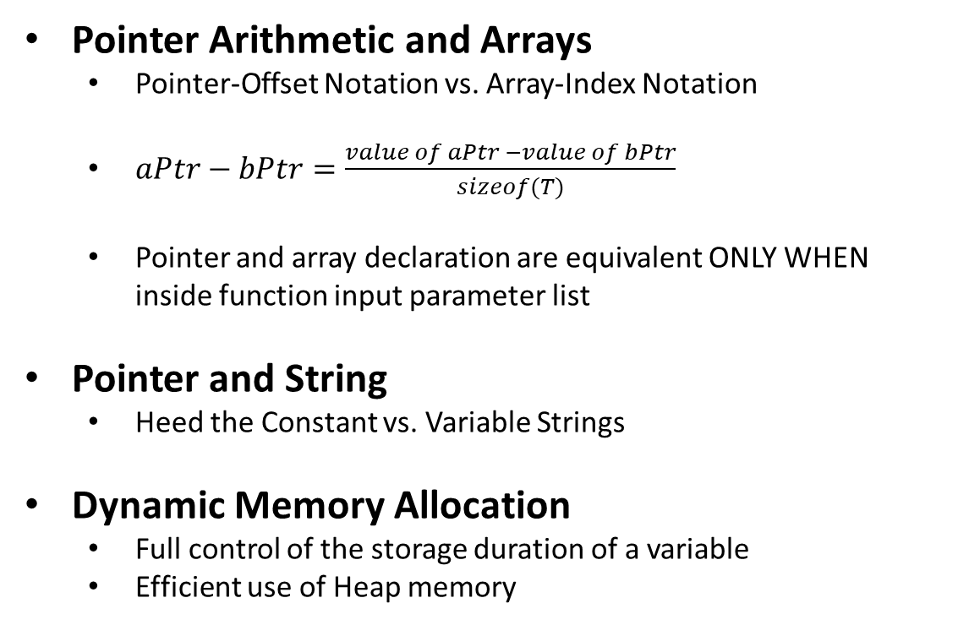
Takeaways
Pointer Arithmetic and Arrays
  Pointer-Offset Notation vs. Array-Index Notation
  $aPtr−bPtr=\frac{value of aPtr −value of bPtr}{sizeof(T)}$
  Pointer and array declaration are equivalent ONLY WHEN
  inside function input parameter list
Pointer and String
  Heed the Constant vs. Variable Strings
Dynamic Memory Allocation
  Full control of the storage duration of a variable
  Efficient use of Heap memory

Slide 31
Homework
Watch [PLV 8-2] const Qualifier on Pointers
(If you have not done so already)
Upcoming
Arrays of Pointers (Multi-Indirection Pointers)
  Motivation
  Applications

